Slide 1

MP RAIR
MULTI-PURPOSE RESCUE AND INVESTIGATION ROBOT
İHSAN IŞIK
FEHIM TRNKA

Slide 2
Bosnia and Herzegovina…

Slide 3
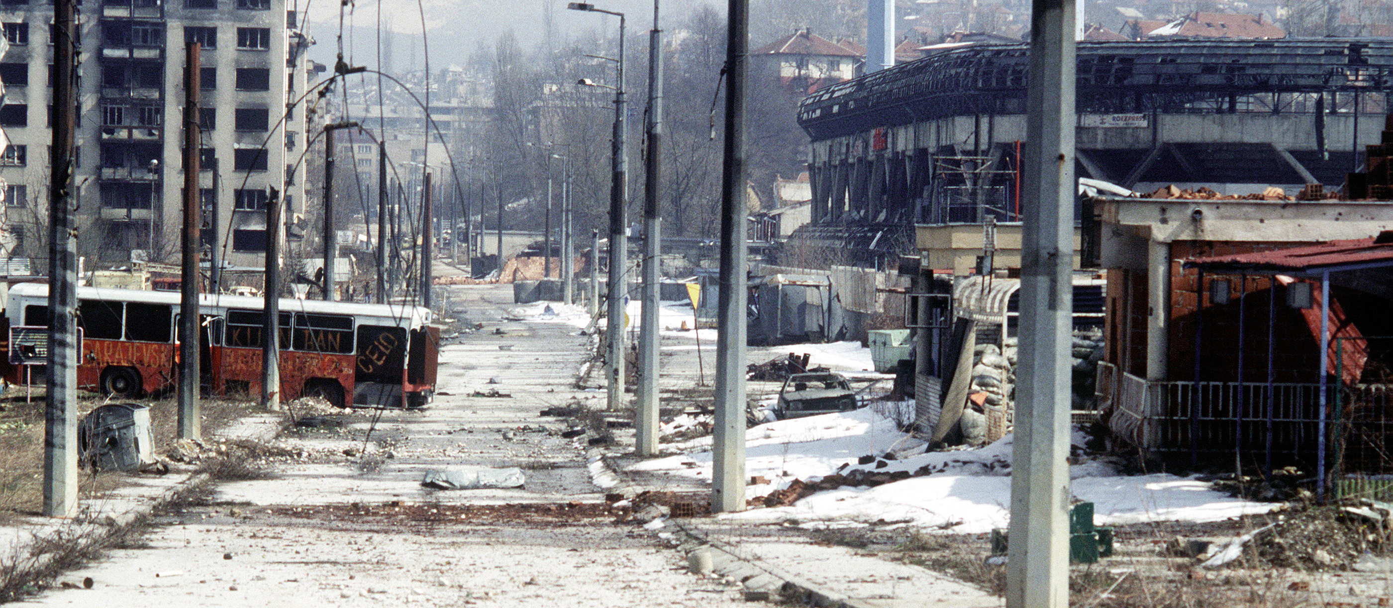
BOSNIAN WAR
The Bosnian War was an international armed conflict that took place in Bosnia and Herzegovina between 1 March 1992 and 14 December 1995. The main belligerents were the forces of the Republic of Bosnia and Herzegovina and those of the self-proclaimed Bosnian Serb and Bosnian Croat entities within Bosnia and Herzegovina, Republika Srpska and Herzeg-Bosnia, who were led and supplied by Serbia and Croatia respectively.

Slide 4
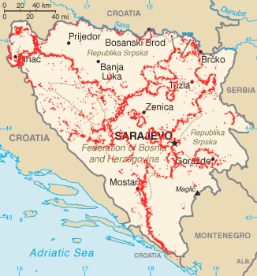
LAND MINES IN BOSNIA
As an after effect of the war land mines laid by all combatants remained leaving Bosnia and Herzegovina with one of the most severe land mine problems of the world.

Slide 5
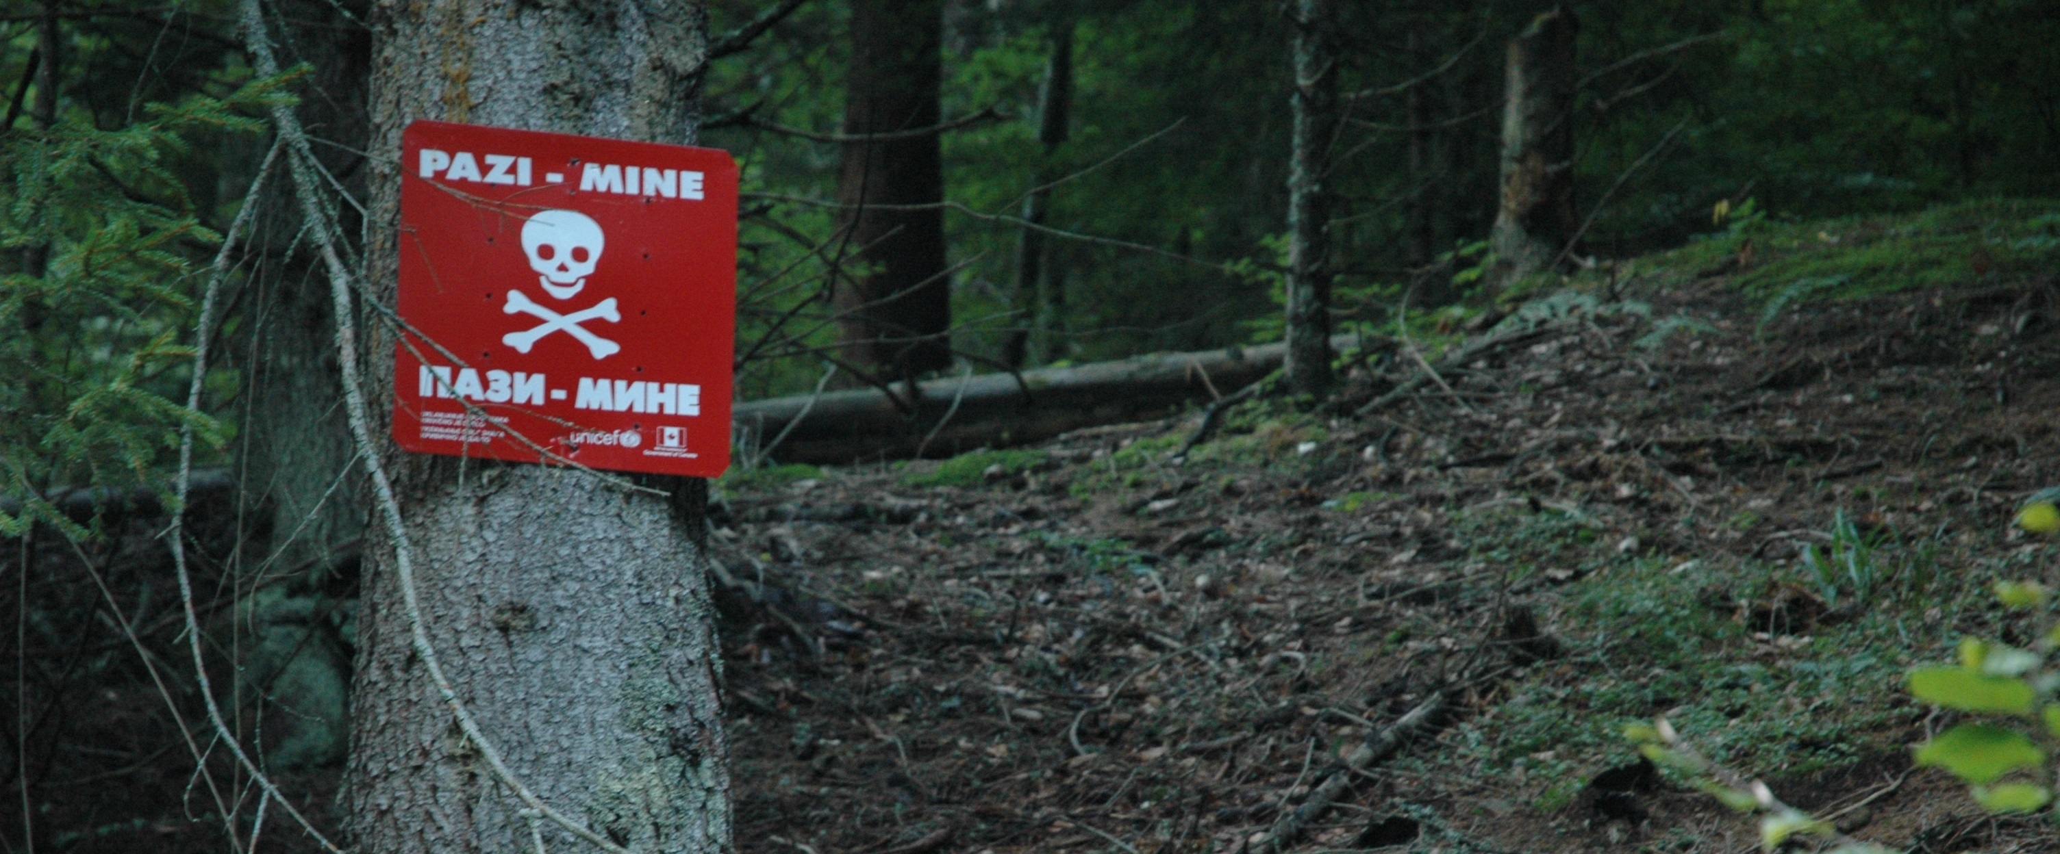
220,000 land mines and unexploded munitions remain scattered in 13,077 locations. A total of 1,755 km².
(3,4% of the Bosnia's whole territory)

Slide 6
CASUALTIES
Land mine casualties in Bosnia and Herzegovina 1996-2009
Year | Killed | Injured | Total
1996 | 110 | 552 | 662
1997 | 88 | 202 | 290
1998 | 60 | 80 | 149
1999 | 38 | 57 | 95
2000 | 35 | 65 | 100
2001 | 32 | 55 | 87
2002 | 26 | 46 | 72
2003 | 23 | 31 | 54
2004 | 16 | 27 | 43
2005 | 10 | 9 | 19
2006 | 18 | 17 | 35
2007 | 8 | 22 | 30
2008 | 19 | 20 | 39
2009 | 9 | 19 | 28
2010 | 6 | 8 | 14
Totals | 498 | 1,210 | 1,717
Source: Land mine contamination in Bosnia and Herzegovina, Wikipedia. 14:40, 10 August 2012.‎

Slide 7
Mine Sweeping…
The process of detecting mines in an area.

Slide 8
METHODS
Manual detection with a metal detector
The process of scanning the area with metal detectors.
Dogs
Well-trained dogs that sniff out explosive chemicals like TNT in landmines.
Rats
Giant pouched rats trained to sniff out chemicals like TNT in landmines. These rats are called HeroRATS. They have the advantage of being far lower mass than the typical human. They are less likely to set off small mines intended to injure or kill people, if the bomb-sniffing animal crosses directly over the top of a buried mine.
Mechanical clearance
Special machines that effectively combine mine detection and removal into one operation. These machines consist of a special vehicle that is driven through the minefield, deliberately detonating the mines it drives over. These vehicles are designed to withstand the explosions with little damage. Some are operated directly with armor to protect the driver; some are operated under remote control.

Slide 9
ACCIDENTS
12:55, 01/06/1999, Bosnia and Herzegovina/ Between Gajevi and Gornjani villages, RS SAMAC/BRVNIK Region. Full Report
NAME REMOVED, surveyor
severe Chest, severe Eye, severe Legs, LOST Toes, LOST Eye.
NAME REMOVED, deminer
severe Legs
NAME REMOVED, surveyor
FATAL
22/03/2008, Bosnia and Herzegovina/ Masici Village, Nr Goradze. Full Report
NAME REMOVED
FATAL
NAME REMOVED
FATAL
NAME REMOVED
FATAL
NAME REMOVED, civilian
Fragmentation Injuries
Sources:
DDAS Accident Report. Accident Number 207, 16/04/2004, http://www.ddasonline.com/PDF_files/DDASaccident207.pdf
DDAS Accident Report. Accident Number 717, 08/07/2011, http://www.ddasonline.com/PDF_files/DDASaccident717.pdf

Slide 10
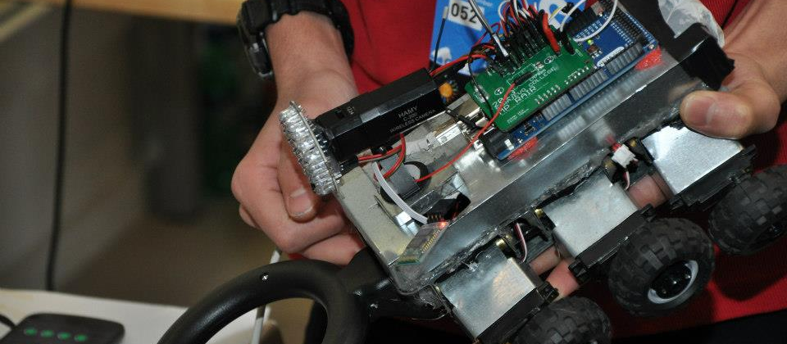
MP RAIR
MULTI-PURPOSE RESCUE AND INVESTIGATION ROBOT

Slide 11
A SIX WHEELED, UNMANNED, REMOTELY CONTROLLED VEHICLE CAPABLE OF MINE SWEEPING AND PINNING DOWN THEIR LOCATION, REMOTE VIDEO TRANSMISSION, TEMPERATURE SENSING, ETC. AND IS REMOTELY CONTROLLED BY MEANS OF WIRELESS COMMUNICATION…

Slide 12
WHEELS
3 independent wheels per side (six in total) increase traction. In other words, they provide better grip to the surface on rough terrain…

Slide 13
NON-INDEPENDENT
INDEPENDENT
SOME WHEELS FAIL TO GET IN CONTACT WITH THE SURFACE.
ALL WHEELS ARE IN CONTACT WITH THE SURFACE. THUS, INCREASING TRACTION.
THIS MAKES IT EASIER FOR THE VEHICLE TO GO OVER ROCKS AND BUMPS ON THE SURFACE.

